Slide 1
IM-115
Lab-3
Best Practice on Visual Elements
Nami Dave (100196893)
Nidhi Gajera (100196892)
September 27, 2019

Slide 2
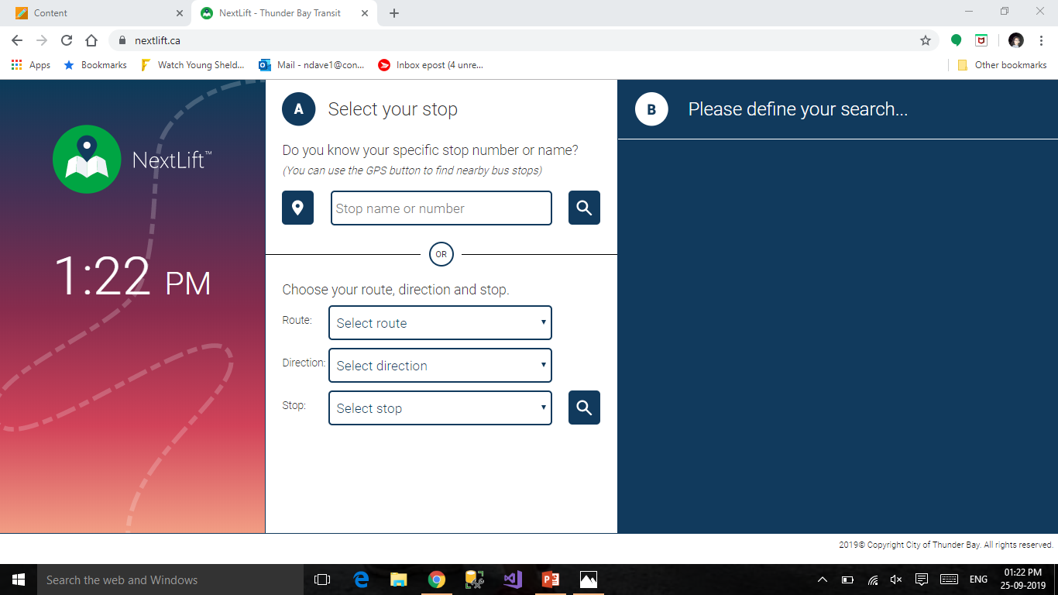
NextLift is the website, where User can search their bus by using search bar. It gives accurate and up to the minute's information of buses.

Slide 3
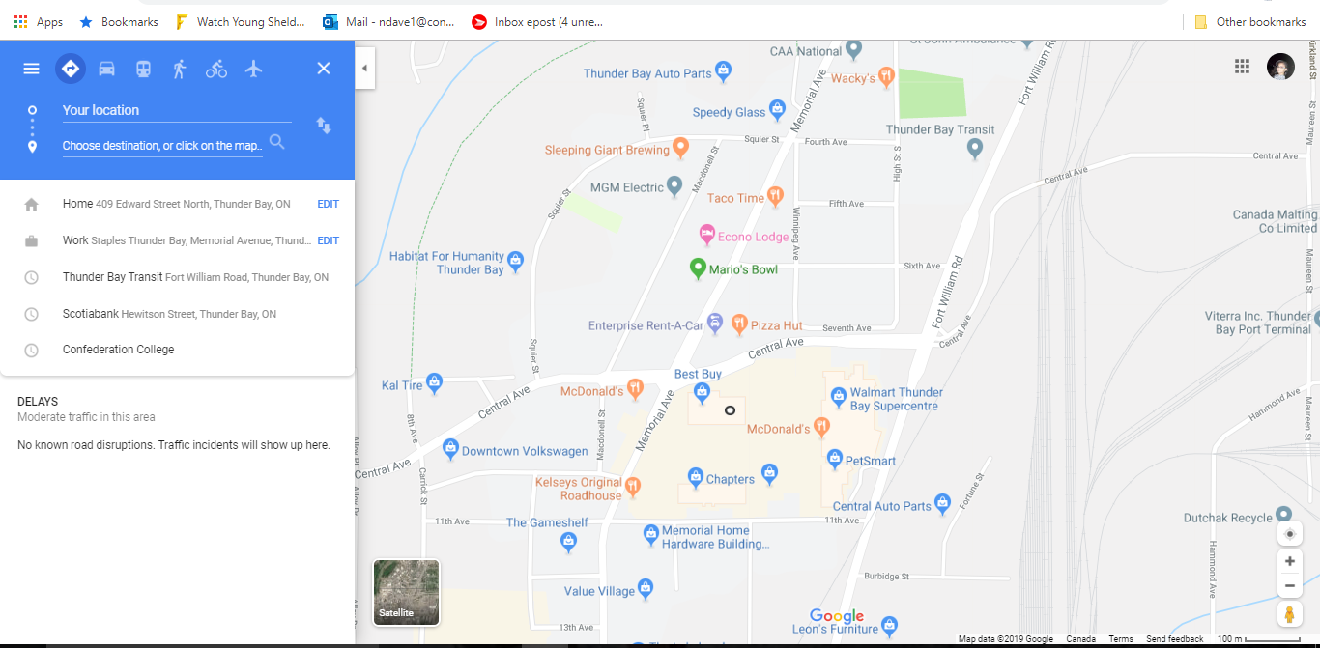
Google Map is a website, where user can find their bus by entering the locations and time. It gives various options for travel.

Slide 4
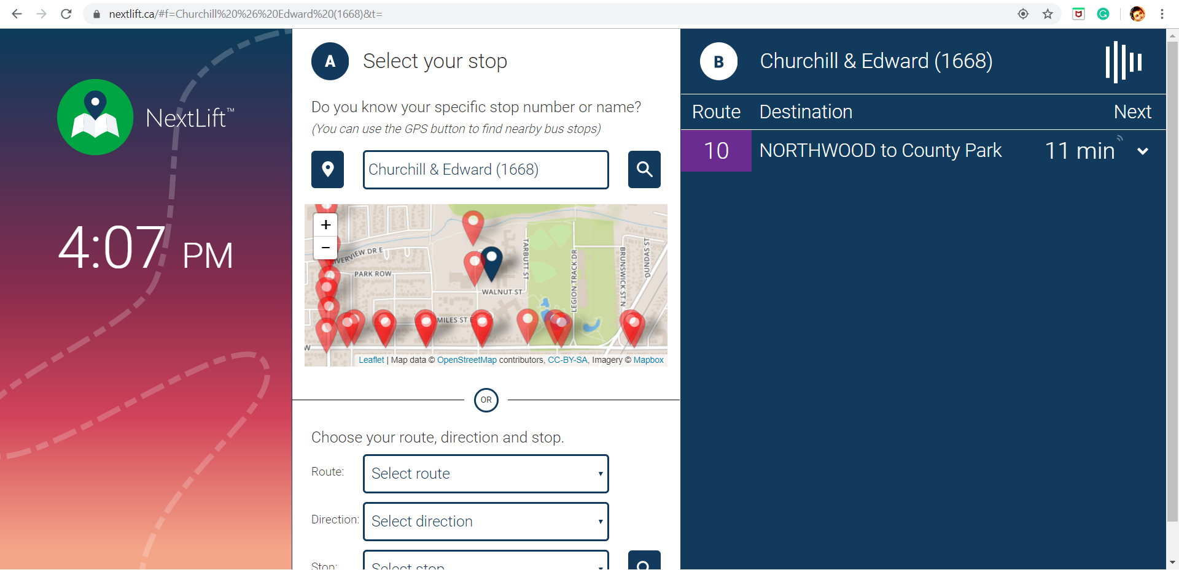
User can add the stop number or name
Stop name and number
Approx time
Bus route name
Bus number
User can see the nearby locations easily.

Slide 5
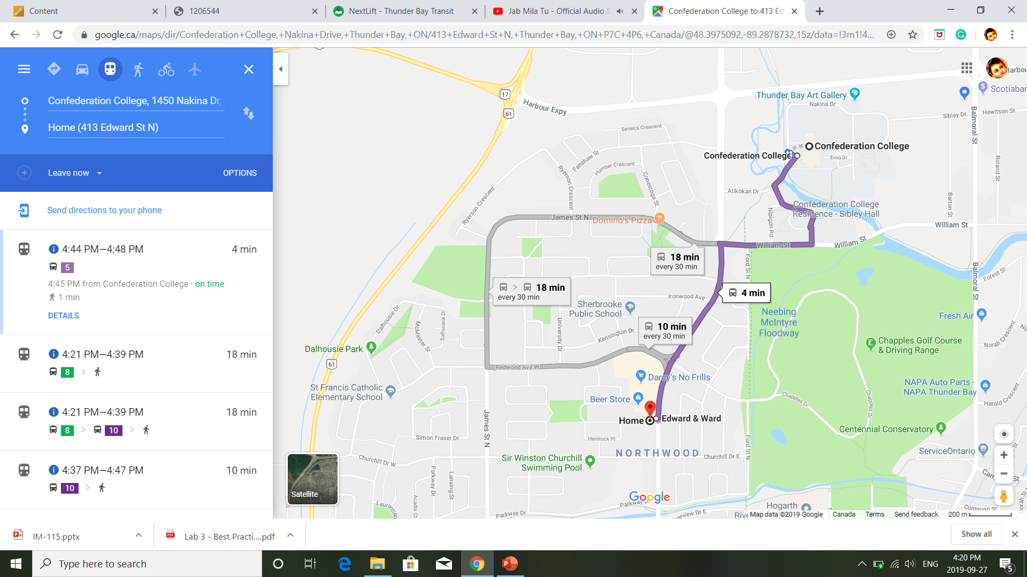
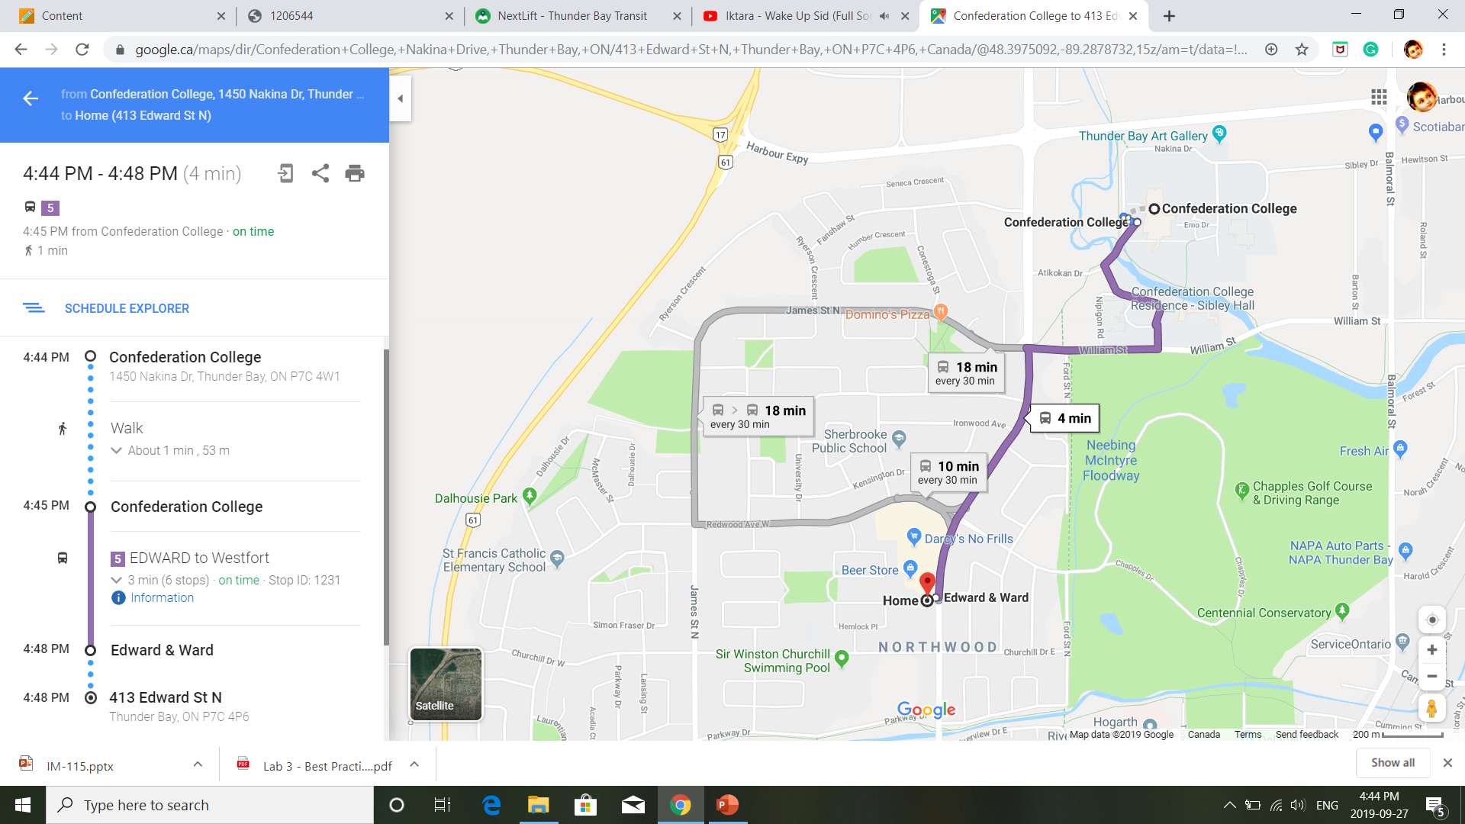
User can see proper directions like, doted line for walk, Purple for bus , bold fonts for important data and symbols like, walk, bus etc.
User can choose appropriate option for travelling, The selected options displayed by dark blue circle
User enters the location
Approx time

Slide 6
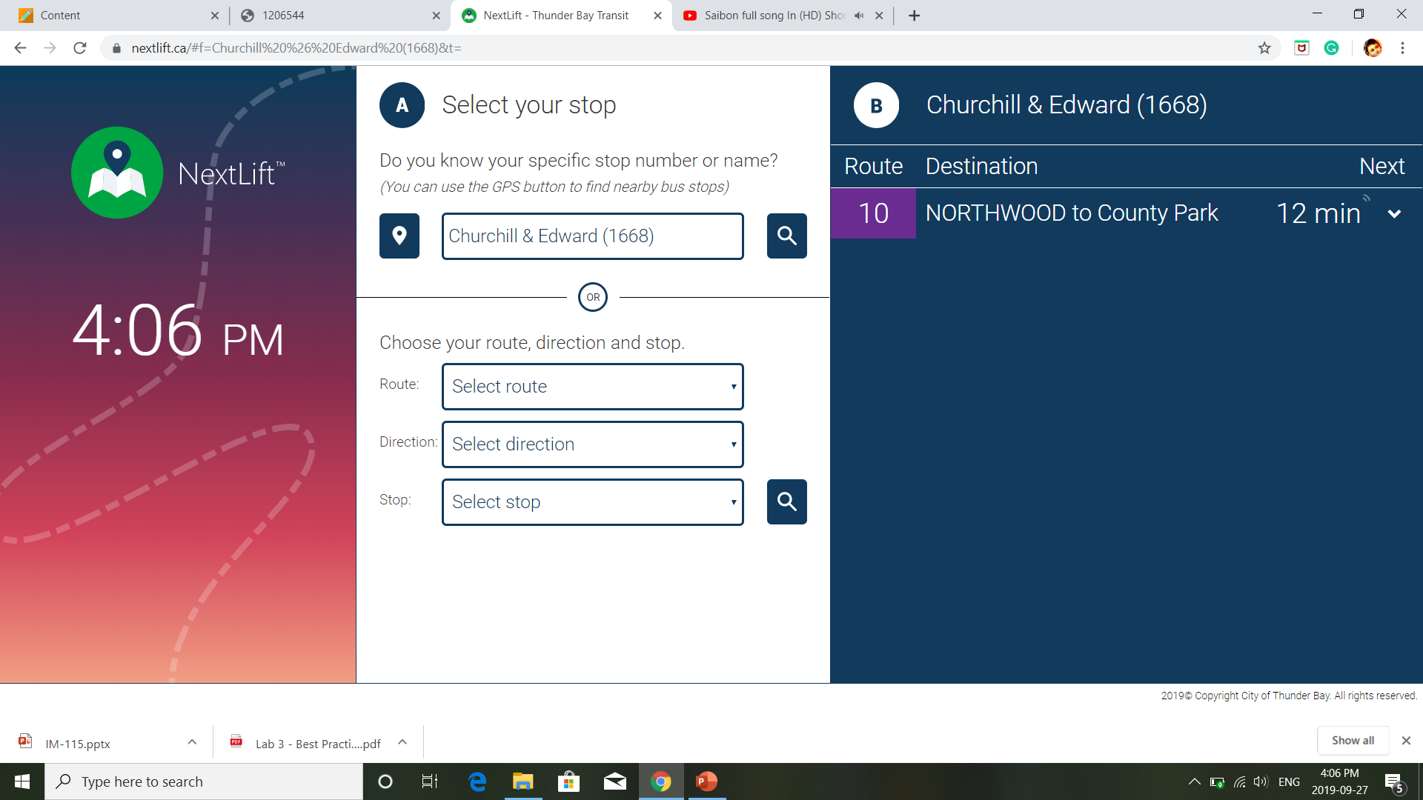

Pros
Cons
It gives real time.
User can see nearby stops and numbers.
Functionality oriented.
Attractive design.
Satisfying user experience.
User can not see other location.
User can only use this service for public transport(bus) only.
Simple layout of website.
User can’t schedule a trip, it just shows two near future rides.

Slide 7

Pros
Cons
It Gives all information.
User can see nearby stops and numbers on map.
IT uses many signs and colors to display their information.
User friendly.
User have more than one options for travel.
User can not get accurate time.
Simple layout of website.

Slide 8
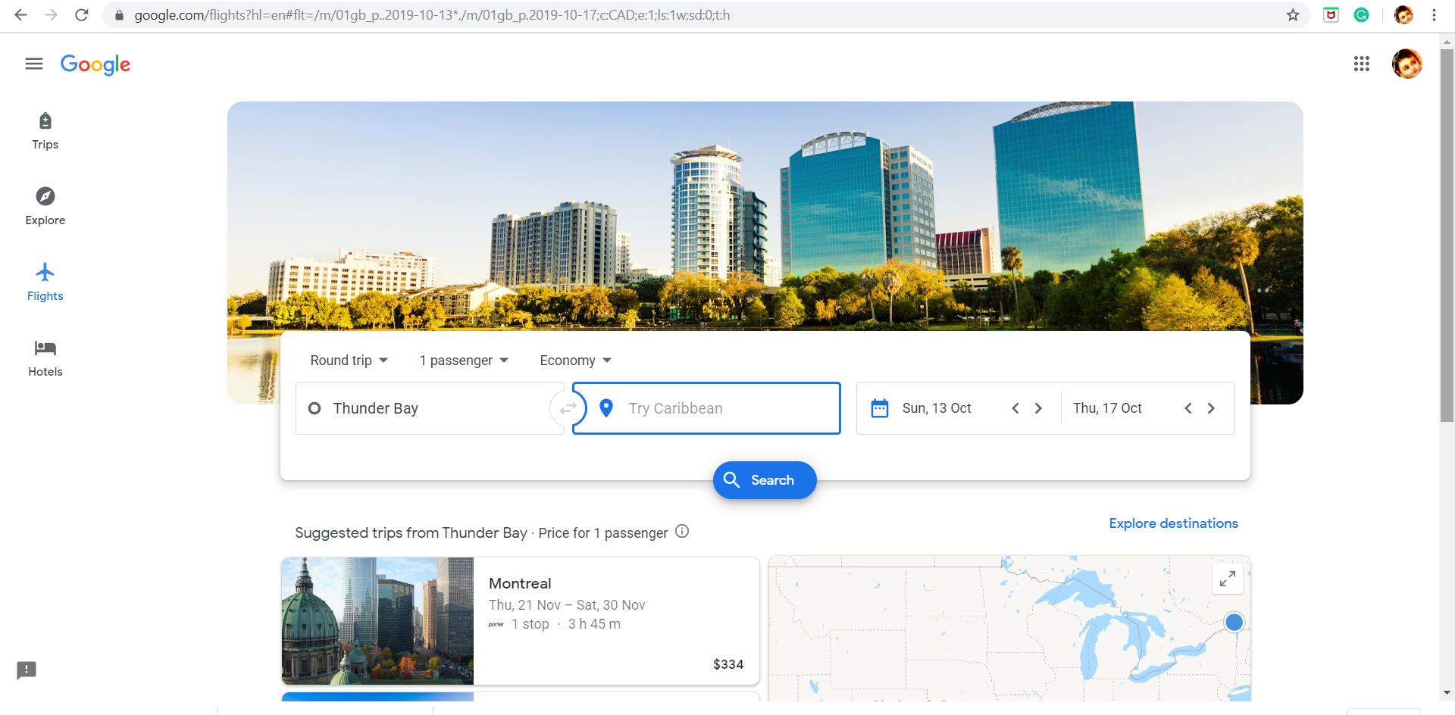
User can search by departure and destination locations to find flights according to date and time.

Slide 9
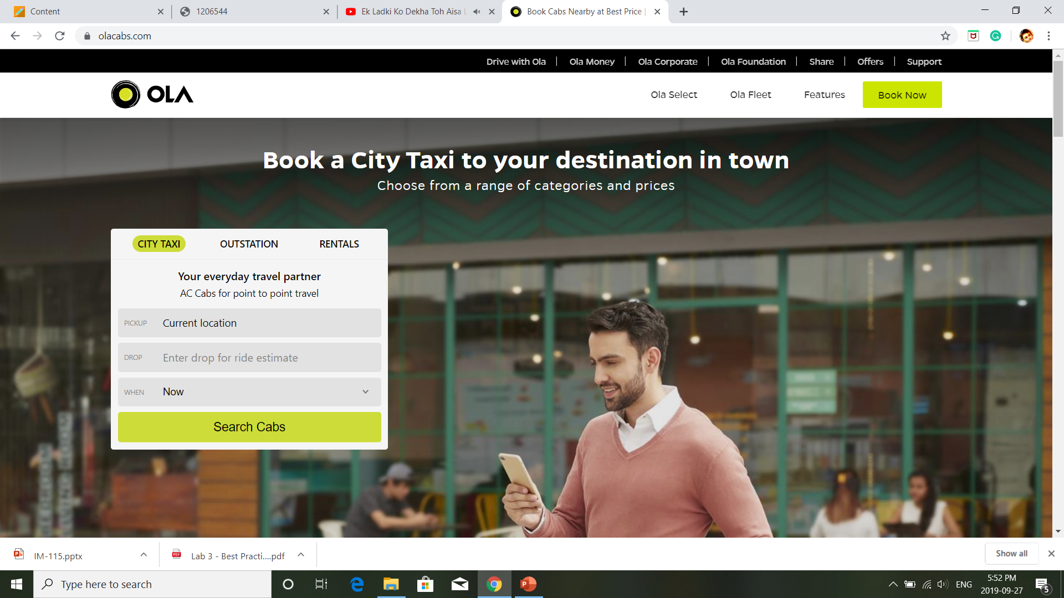
User can enter pickup and drop locations.

Slide 10
Factors which affects above websites layout
NextLift
It has perfectly partitioned design, user can see all the parts without scrolling in any direction.
It is compatible for all the devices, has auto-sizes functionality to fit in all devices.
It has the search bar which is created with autocomplete functionality, which helps user to do quick search of bus-stop. It provides users to search bus from nearby bus-stop.
It has wise colour combination to support weak eye site as well and well aligned content.
It shows the current time, and rides in near future.
Google Maps
It has the powerful database to search current location and gives suggestions.
It has the different options to find the best transportation with duration.
It can show you all possible rides possible.
It is not limited for just one city its in use worldwide.

Slide 11
Factors which affects above websites layout
Flights
It provides user friendly experience.
It allows user to add destination and departure location with date and time to search the convenience flight.
It gives result of all available flight-list with all details of flights.
This website contains responsive layout with attractive price graphs and other filters.
OLA
It allows user to enter pickup and drop points with various time options like, on time or schedule the trip.
It uses the google map to search the location.
The website layout is attractive and user friendly.
Even though it is using third party API, the speed remains the same as normal website.
The form and font layout is simple and responsive to display various kind of devices.

